Slide 1
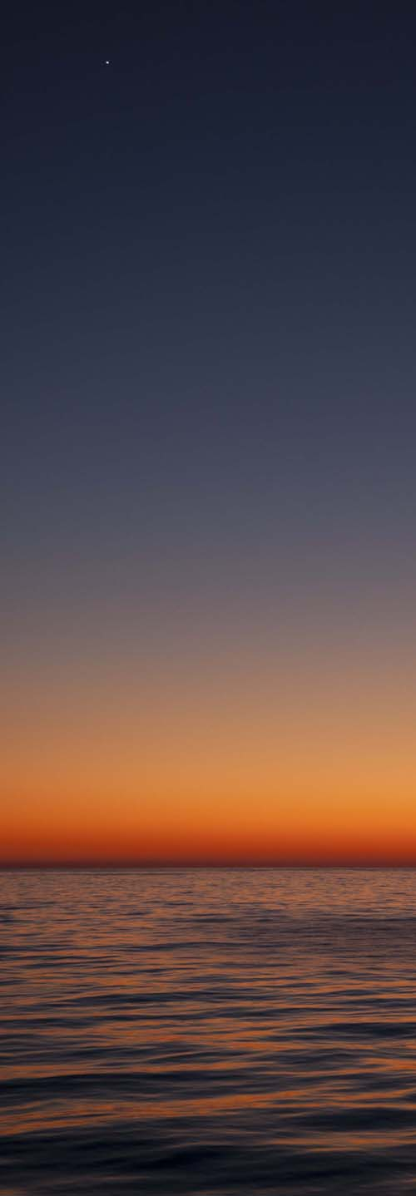
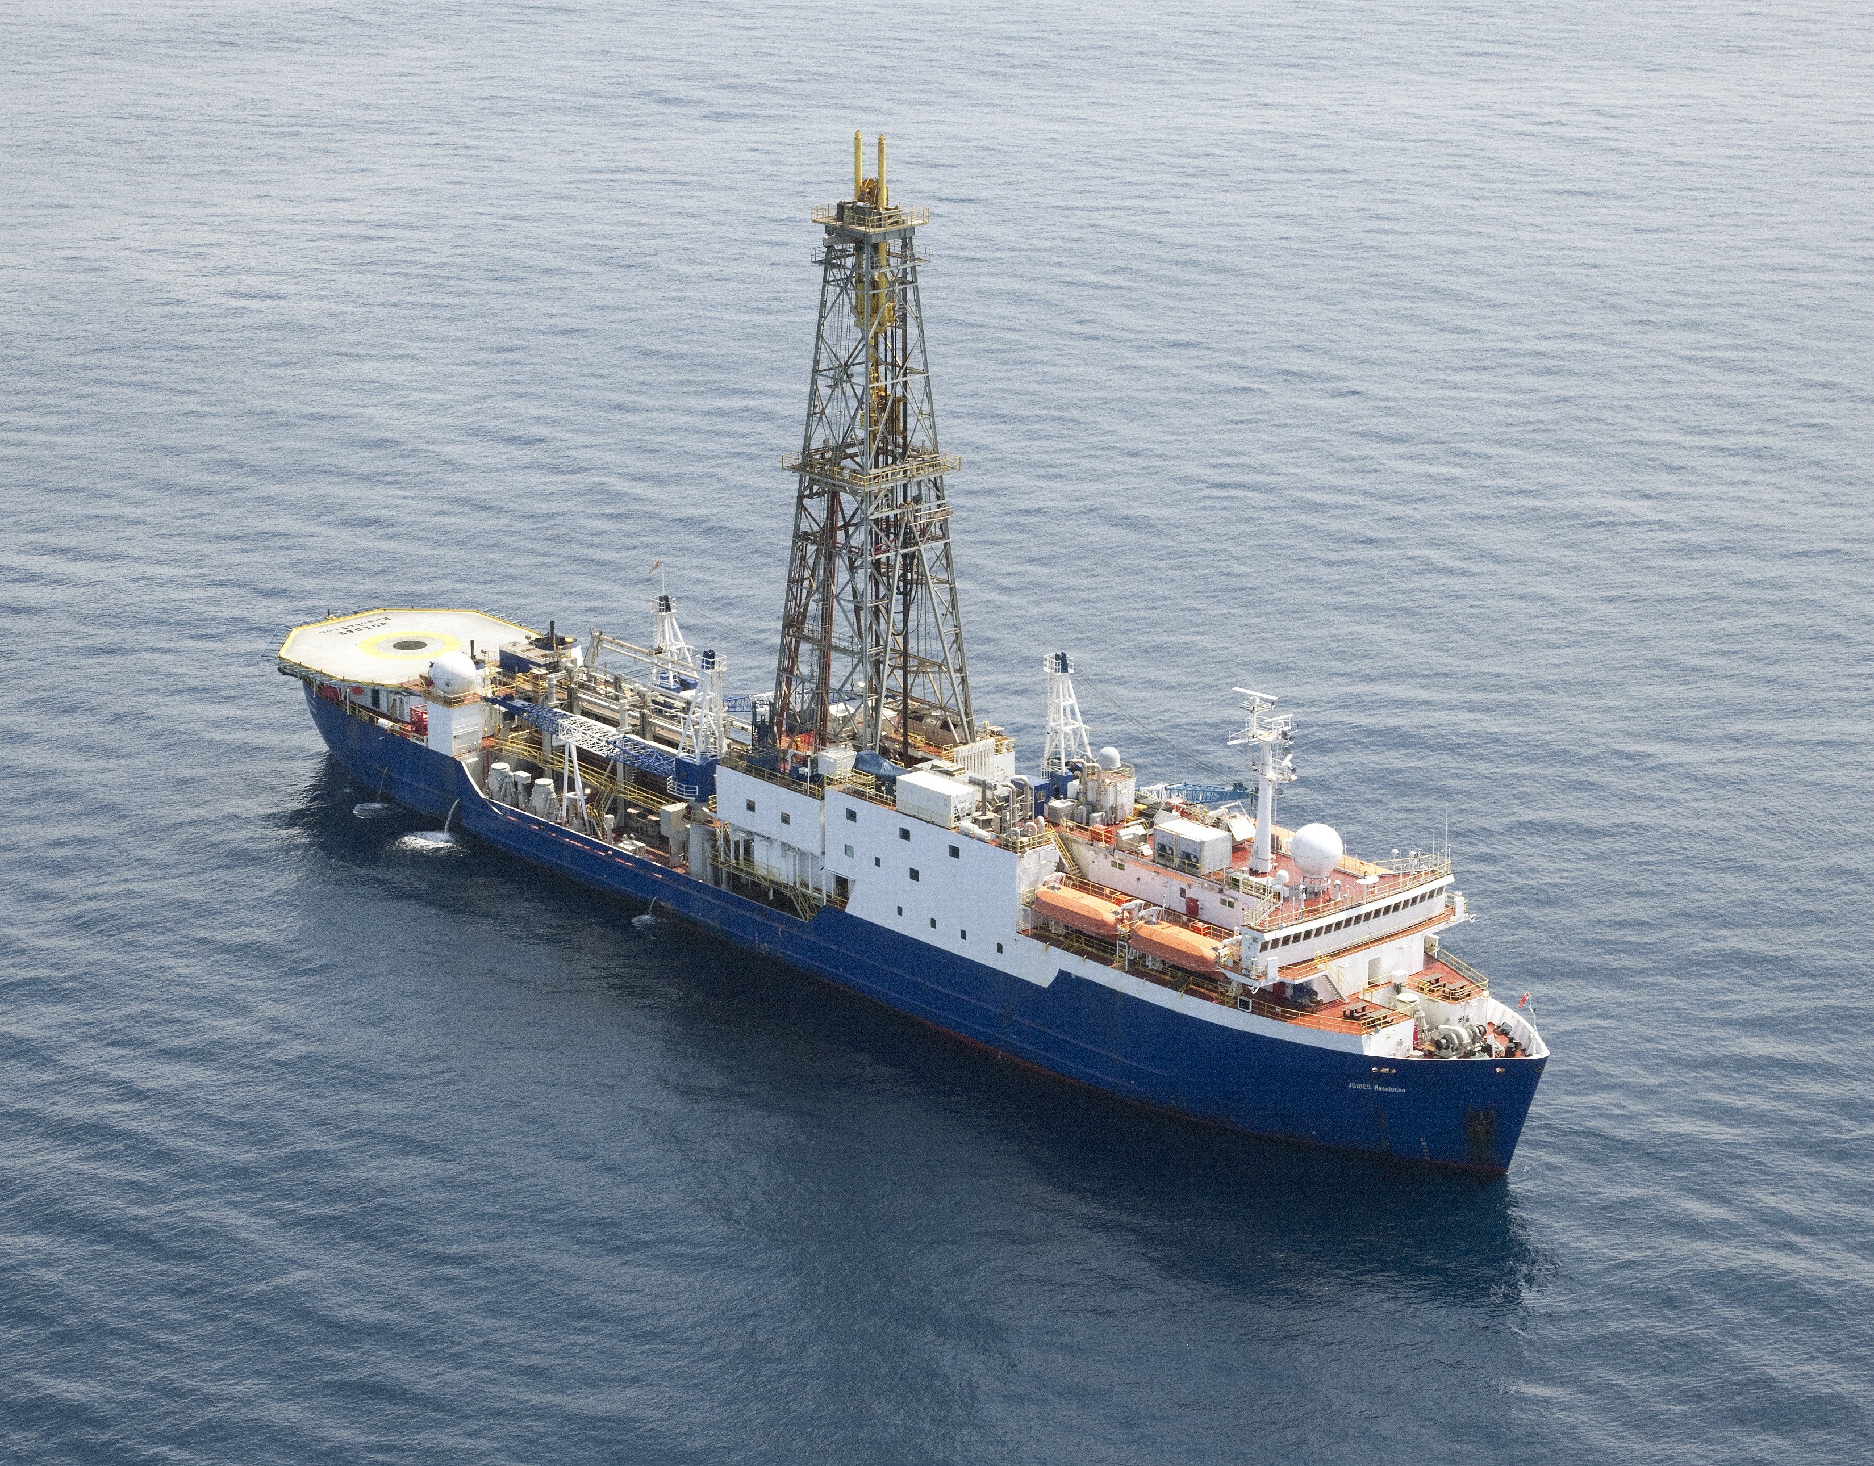
JOIDES Resolution memories, Dorrik Stow (Co-Chief, ODP116 and IODP339)
Haiku
Sea Duet
sea duet – red glow
forward, aft the pale full moon
strings of our soul quiver
Sunset
as sunsets dissolve
to starlight and darkness
so life it revolves
Midnight
midnight solitude
the silver moon casts shadows
‘cross the paths of time
Dorrik Stow, 1987
JOIDES Resolution, ODP 116
Picture credits: Sunset glow (this page and next) – John Beck, TAMU
Sunrise over grey sea (last page), Carlos Alvarez Zarikian, TAMU

Slide 2
Indian Ocean Dreams
In a silver world of moonlight
The black swell’s hidden power
A ship emerges from darkness
Sun clips the drilling tower
To stand and watch at the gunnels
As the mystic dawn dissolves
And the galley fills with laughter
Merriment and work revolves
Through each long day in that vastness
On the sunbaked metal deck
The tangled strands of my lifetime
Laid bare like an old shipwreck
The rope is knotted and naked
Intrigue, confusion and love
The ends are fraying and salted
Light, fickle but strong enough
My luck is that of a sea charm
My spirit blown with the winds
Sweet love – the eye of a ruby
My future still buried in sand
And so I dream with the sunset
The moon, the stars in the sky
Of love that dances on silver-
Capped ripples, swirls as I sigh
Dorrik Stow, 1987
JOIDES Resolution, ODP 116
Twilight thoughts
Strident, angled, powerful…
the drilling rig towers mid-ship
a lost cacophony of light and sound
astride the lonely silence of this graphite sea.
There is a hidden place I like to find
forward and starboard, shielded by lifeboat 3
beneath the bridge-deck parapet
with muffled roar, a corner of darkness hides.
I stand at the gunnels, lean to the wind
watch keenly as one by one, more by more
the mica glint of tiny stars invade my thoughts
and grey sea mist blends with a distant sky.
Suddenly, from nowhere to nowhere
a silver streak fires and fades, cutting
clear and clean across the tissue of night…
In that moment … I think of you.
Dorrik Stow, 2011
JOIDES Resolution IODP 339

Slide 3
Twilight thoughts
Strident, angled, powerful…
the drilling rig towers mid-ship
a lost cacophony of light and sound
astride the lonely silence of this graphite sea.
There is a hidden place I like to find
forward and starboard, shielded by lifeboat 3
beneath the bridge-deck parapet
with muffled roar, a corner of darkness hides.
I stand at the gunnels, lean to the wind
watch keenly as one by one, more by more
the mica glint of tiny stars invade my thoughts
and grey sea mist blends with a distant sky.
Suddenly, from nowhere to nowhere
a silver streak fires and fades, cutting
clear and clean across the tissue of night…
In that moment … I think of you.
Dorrik Stow, 2011
JOIDES Resolution IODP 339

