Slide 1
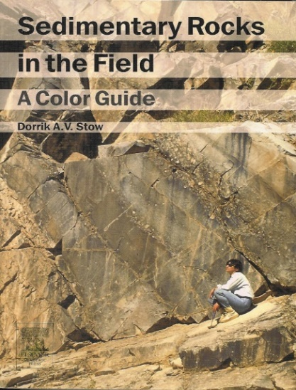
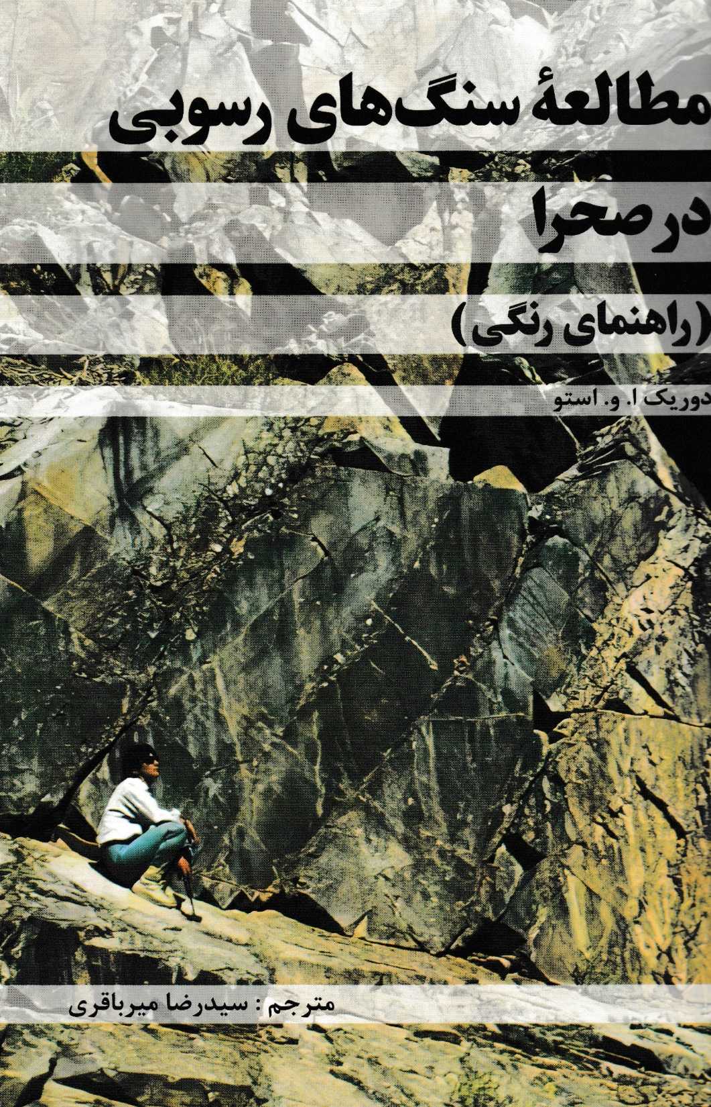
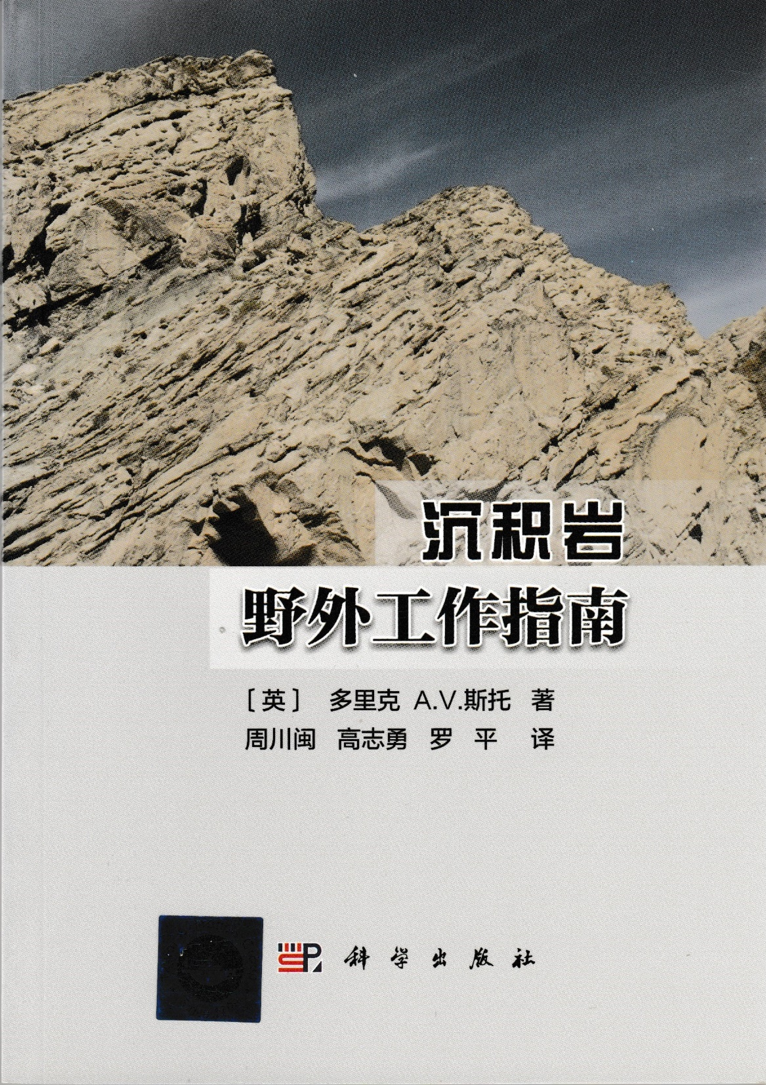
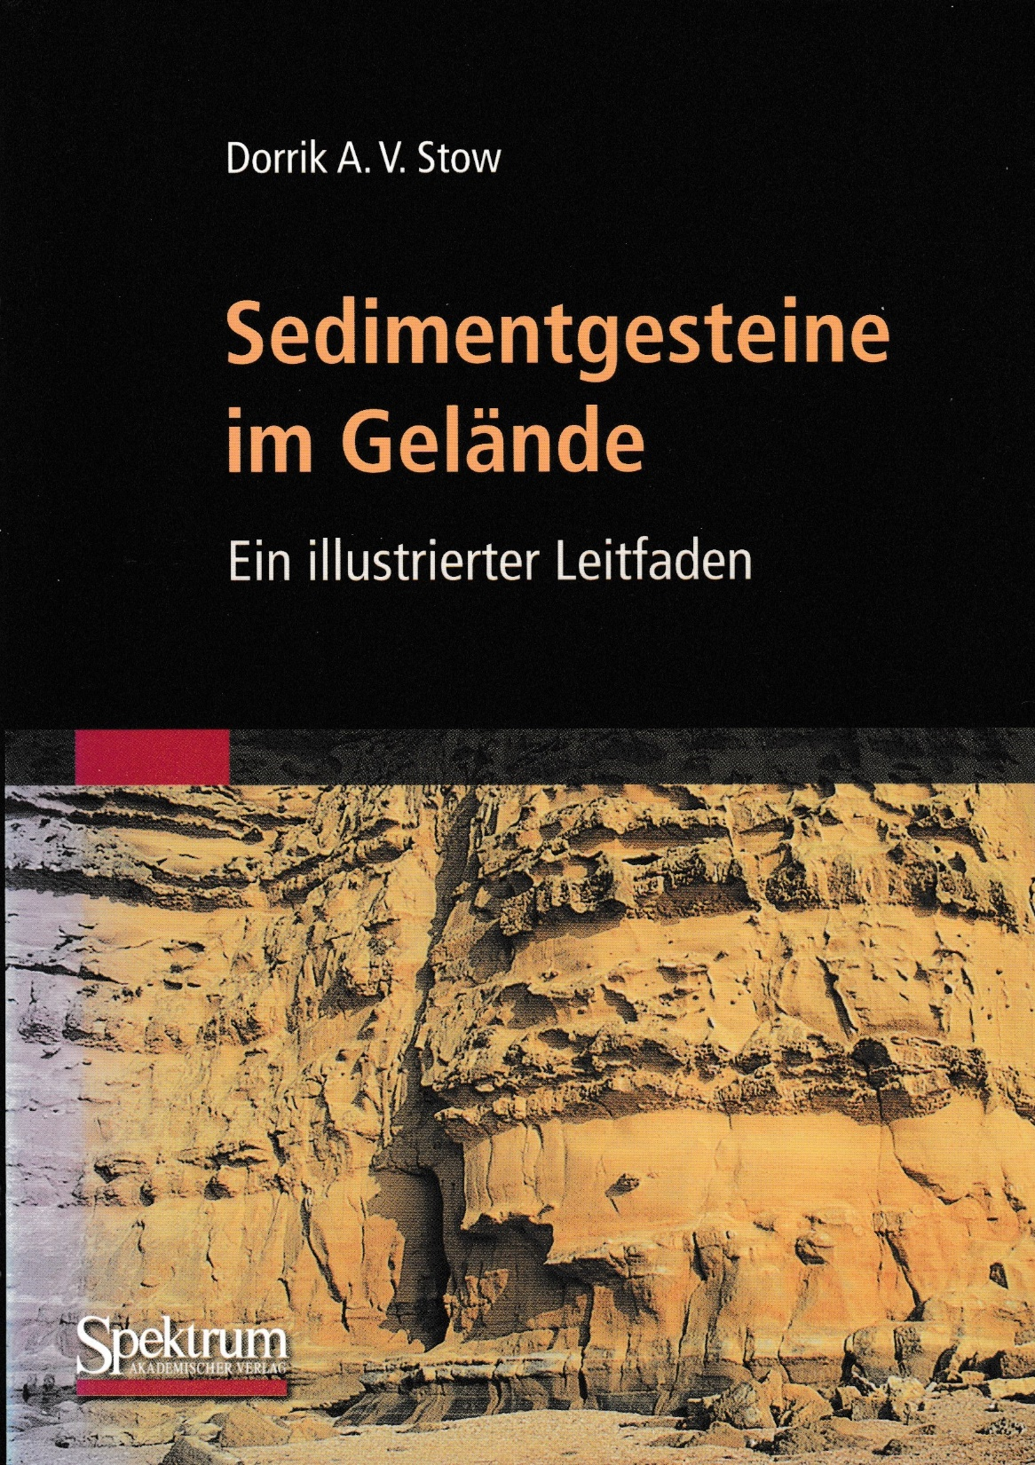
Stow 2005, Sedimentary Rocks in the Field: A Colour Guide, Taylor & Francis Publishers, with Arabic, Chinese and German translations
Stow 2027 (in progress). Sedimentary Rocks in the Field and Core: A Colour Guide, Taylor & Francis Publishers, New revised edition with additional field photographs, a new section on trace fossils, and the addition of numerous core photographs.
Link: https://doi.org/10.1201/b15204

