Slide 1
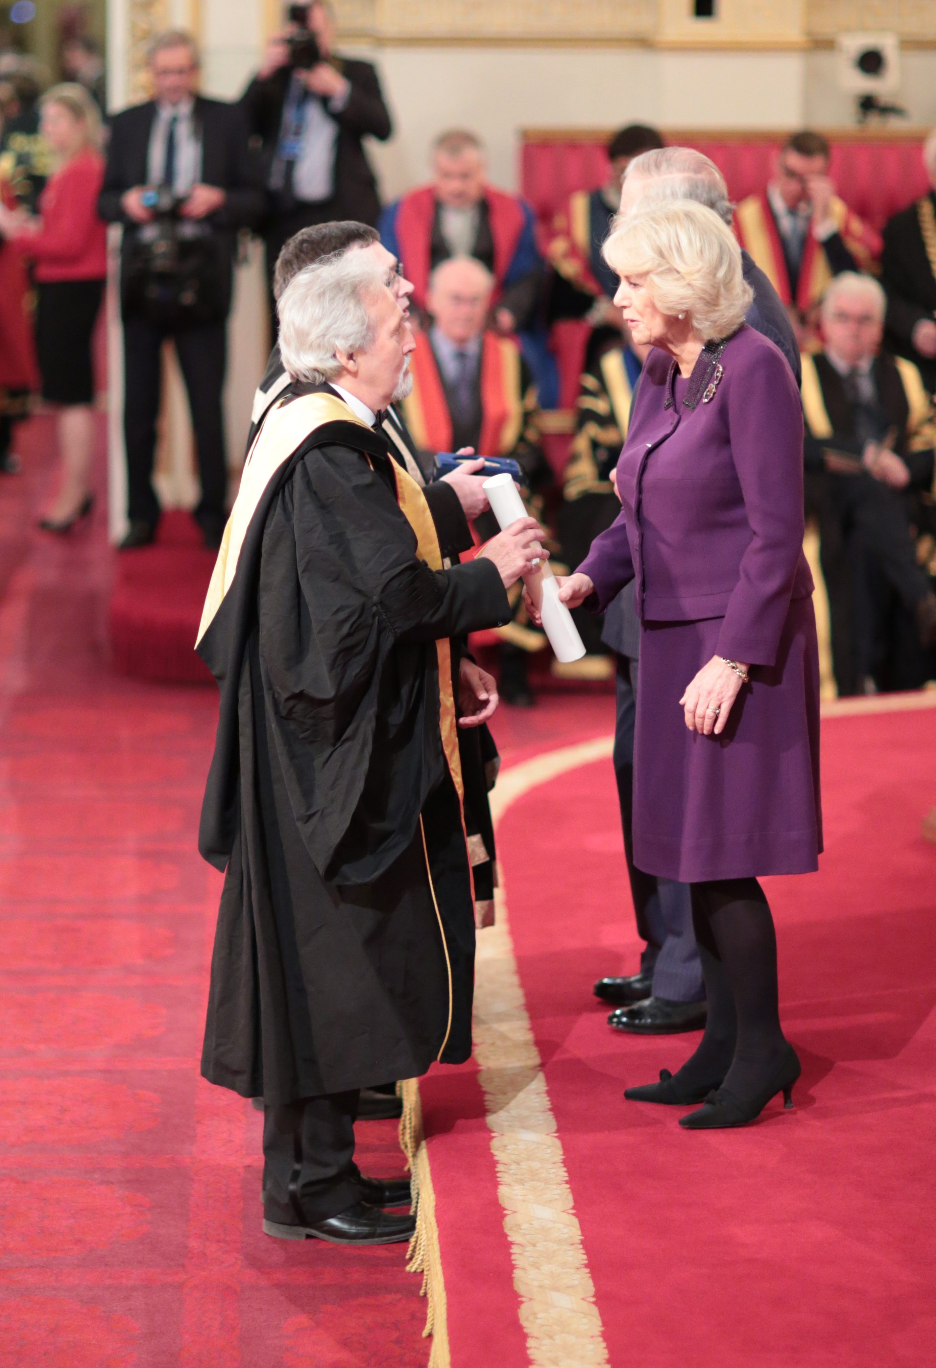
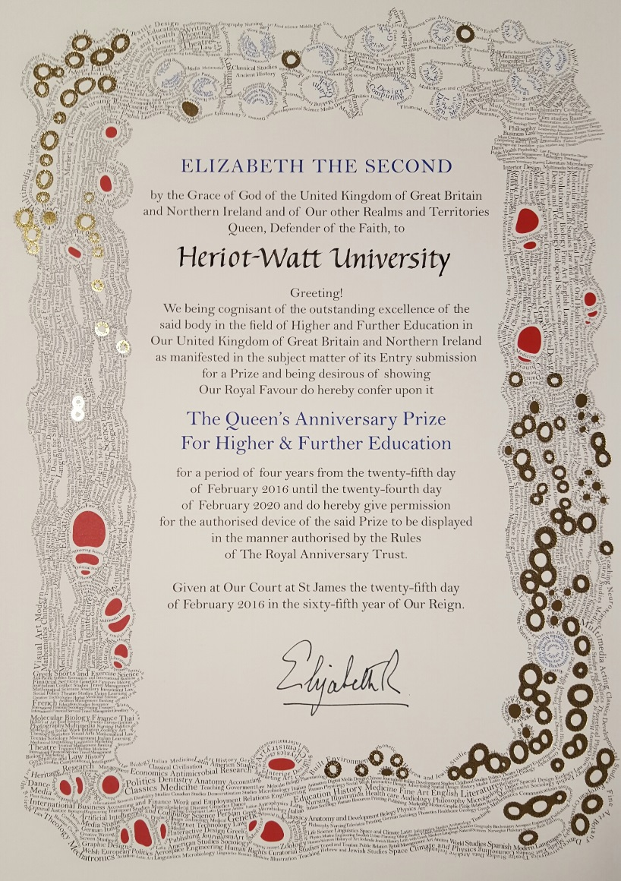
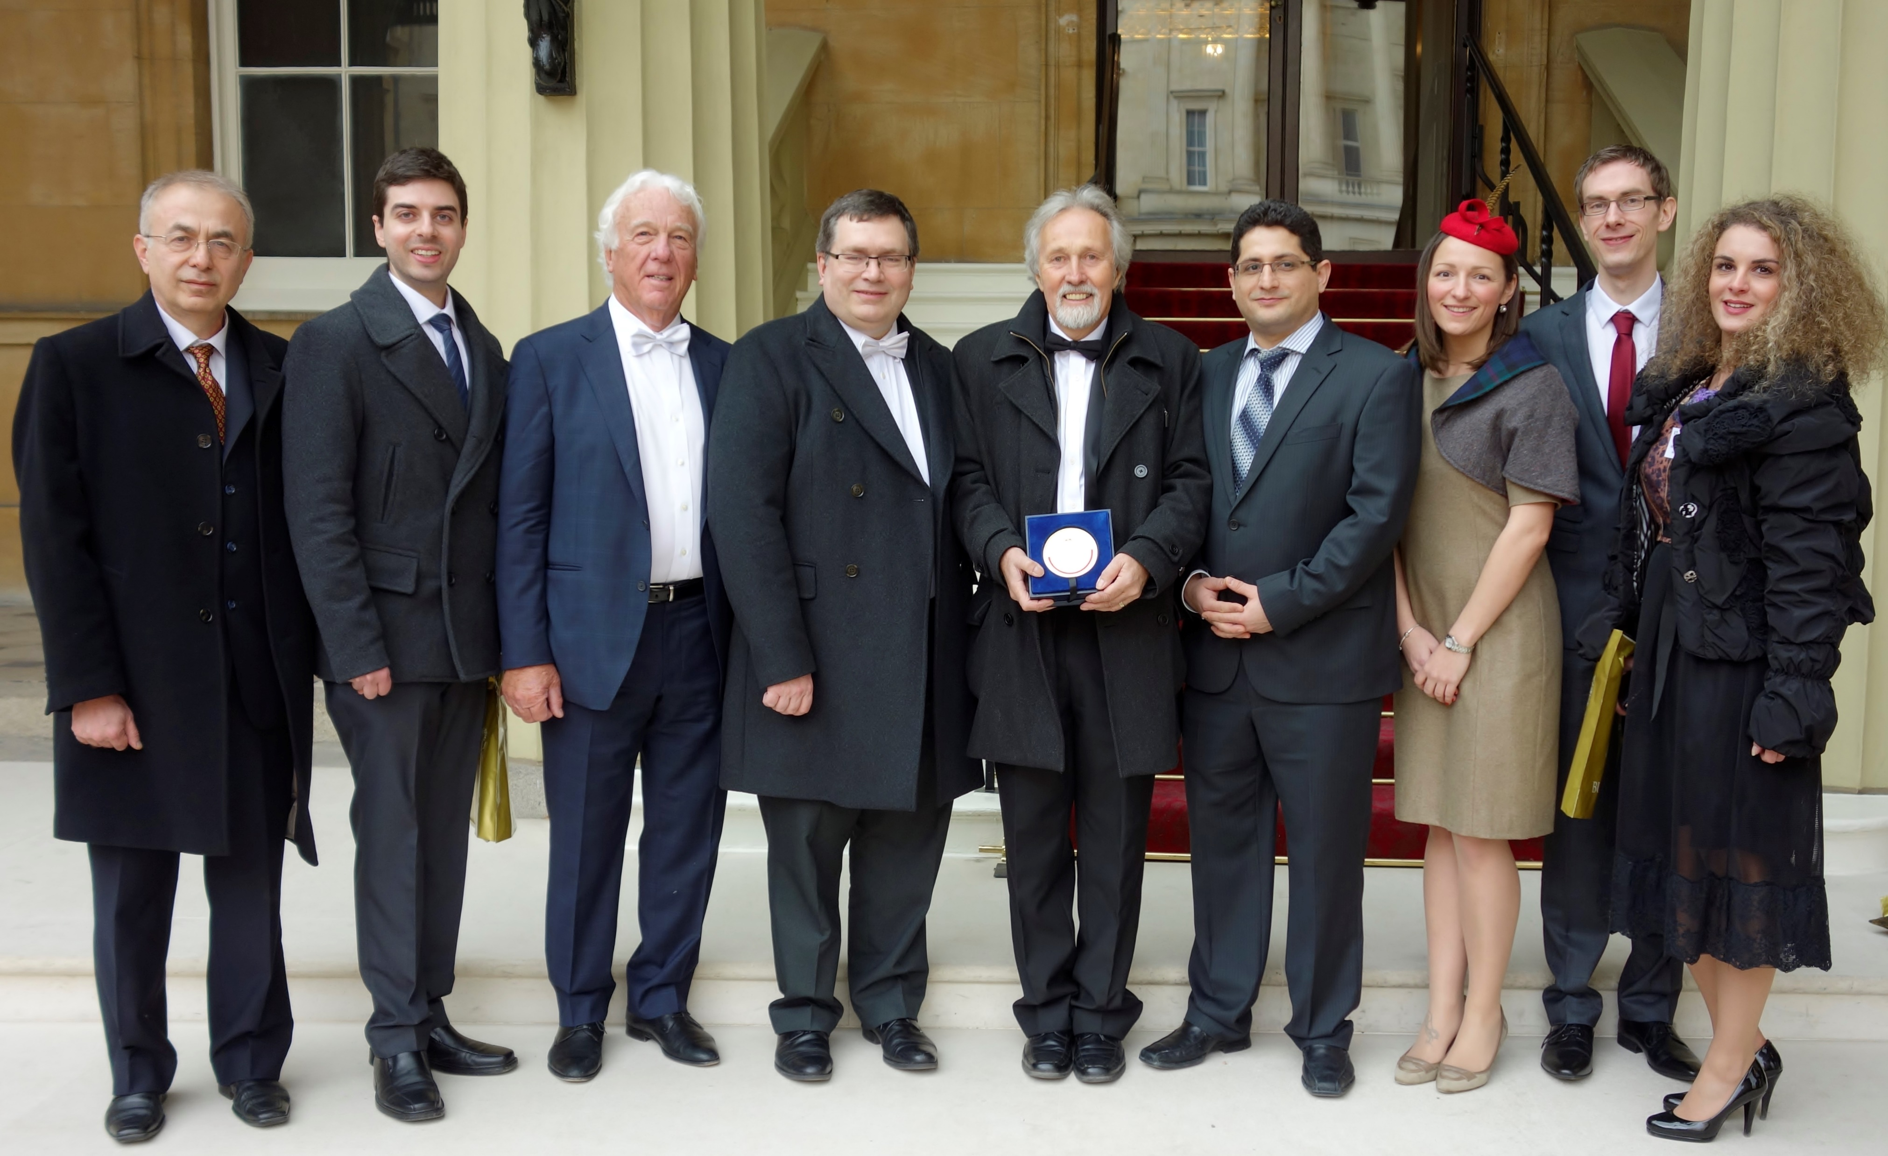
Queen’s Anniversary Prize 2016-2020
For Energy Innovation in Higher & Further Education
Buckingham Palace Award with Charles & Camilla 2016

