Slide 1
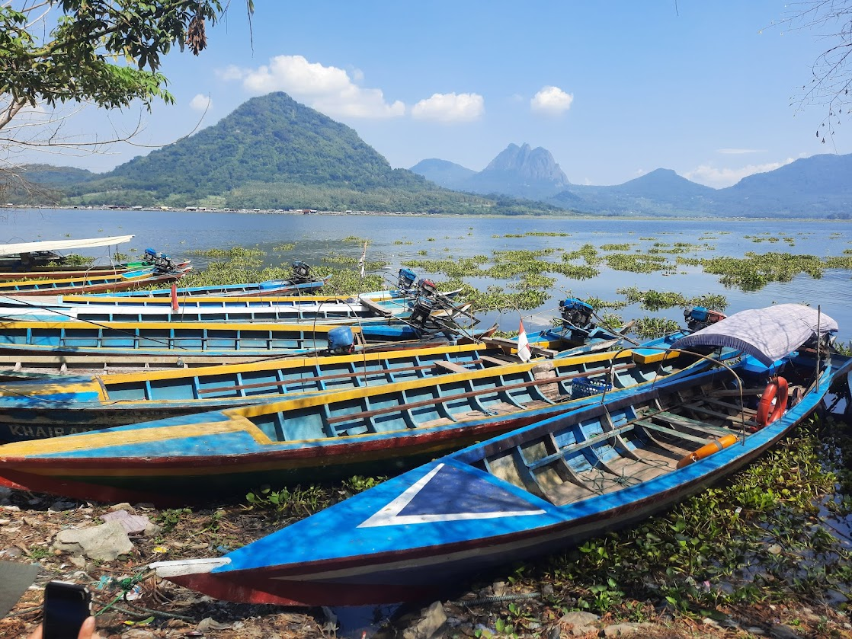
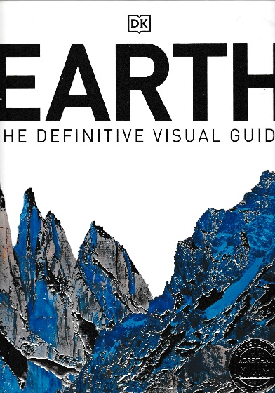
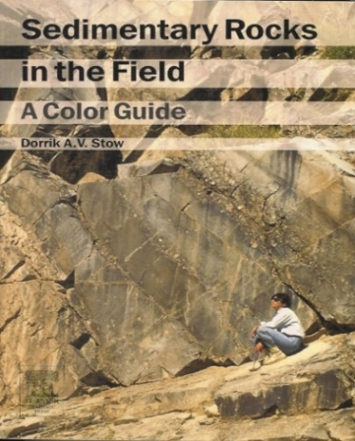
ENRICHMENT LECTURES
Professor Dorrik Stow: Geologist, Oceanographer, Author, Consultant
Research specialist in deep oceans, energy resources, SE Asian geology
Jatiluhur, West Java
FROM Bangkok –TO Hong Kong
Silver Whisper – 25 Feb to 9 March 2025

Slide 2
Professor Dorrik Stow is an internationally renowned geologist and oceanographer, a world authority in his field. He is a lively, informed and highly interesting speaker. He draws upon a wealth of knowledge and experience from his work across the world, both on land and at sea, to fully illustrate his presentations. As an enthusiastic public speaker and cruise-line enrichment lecturer, on everything from deep ocean mysteries and long-vanished oceans to energy futures, global climate and natural hazards, he brings an engaging level of originality. He has led scientific cruises to all the world’s major oceans, worked and lectured in more than 50 countries across the globe, and published extensively. This includes several popular science and illustrated coffee-table books on the earth and oceans. He is Emeritus Professor at Heriot Watt University in Scotland, Fellow of the Royal Society of Edinburgh, and continues a very active research agenda, including in China, Japan, New Zealand and Europe.

Slide 3
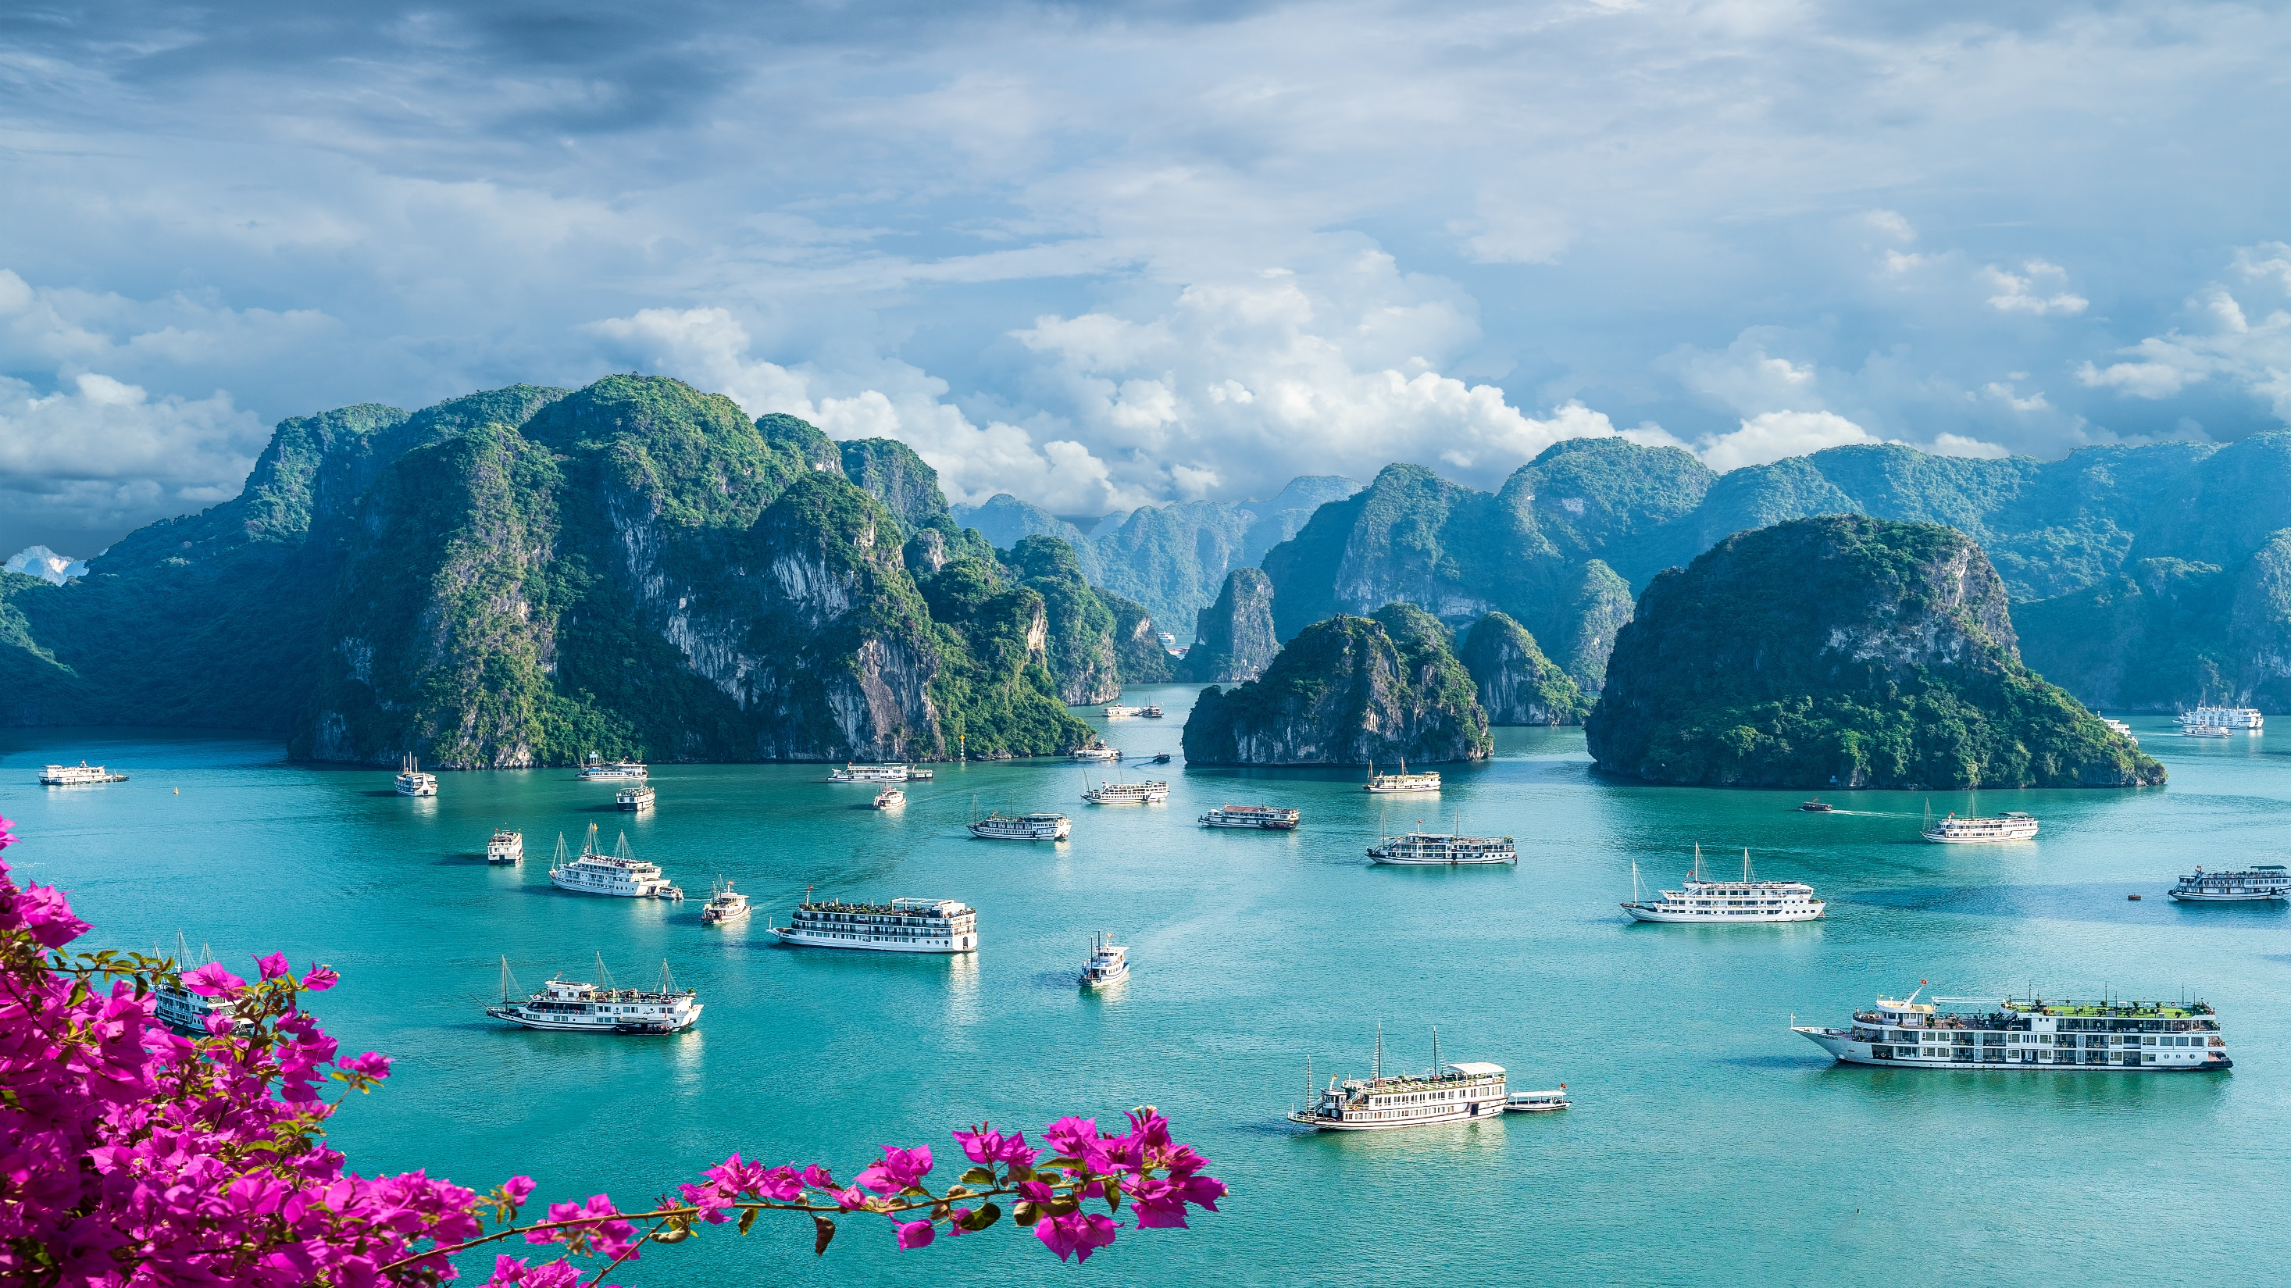
1. Jigsaw Puzzle of Southeast Asia
Halong Bay, Vietnam

Slide 4
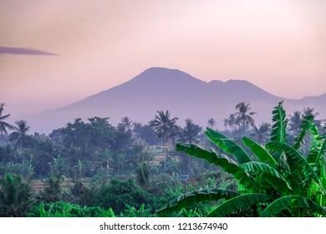
2. Islands in Time
Bali Island, Mt Batukaru

Slide 5
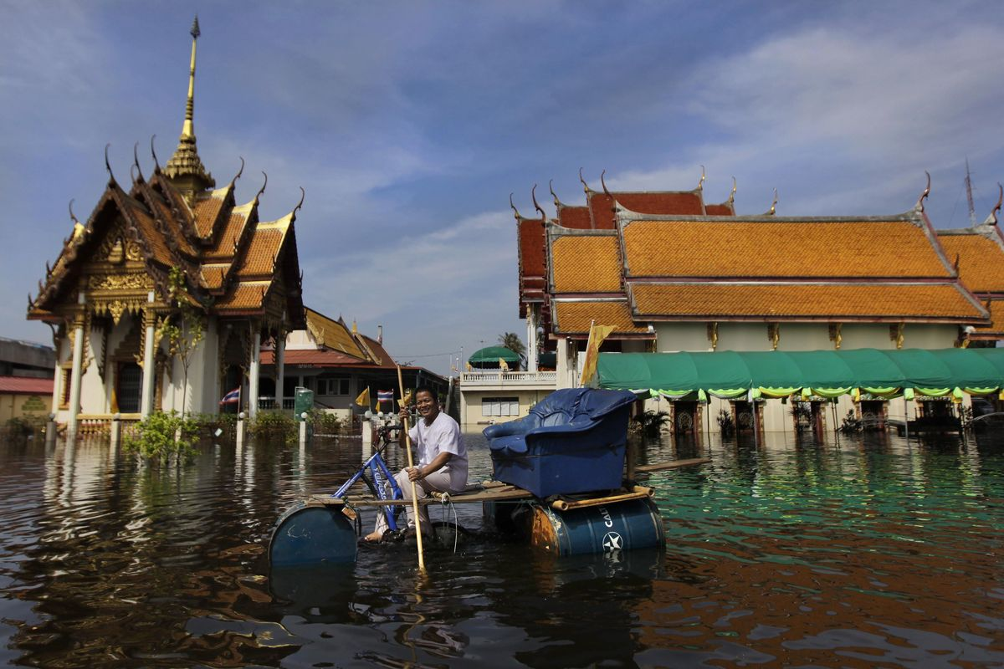
3. Sinking cities, Rising Seas, Climate Change
Streets of Bangkok

Slide 6

4. Scramble for oil in Global Energy
the South China Sea Sustainability

Slide 7
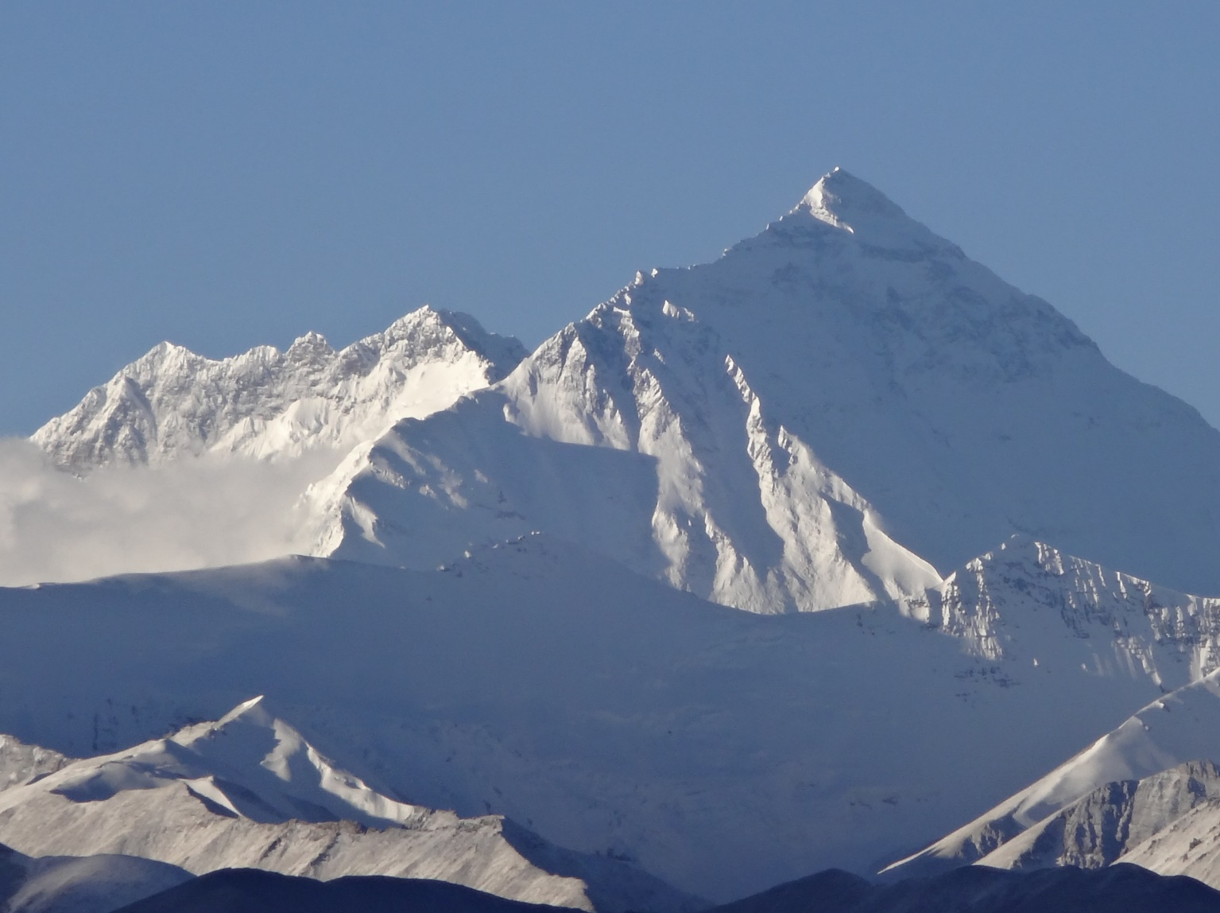
5. Mighty Rivers of Southeast Asia
Everest from Tibet

